Slide 1
LIBRARY MANAGEMENT SYSTEM
Software Construction and Development Project
Presented to:
Miss Abeeha Sattar
Prepared by:
M. Ehtesham Zafar (20k-1655)
Hassan Ali (20k-1052)
Amna Mubarak (20k-1695)

Slide 2
CONTENTS
1
INTRODUCTION
2
DESCRIPTION
3
SOFTWARE FEATURES
4
SOME PICTURES

Slide 3

INTRODUCTION
With the increase in the number of readers, better management of the library system is required. The goal of the library management system is to enhance the administration of libraries in a city or community. Librarians now have all the tasks automated and with a click of a some buttons they can perform the tasks in seconds which would require much time doing manually.

Slide 4

DESCRIPTION
This system will provide a search functionality to facilitate the search of resources. This search will be based on a number of categories, and users can look up a book by book’s name, author's name or book ID. Moreover, the library staff members have the authority to add, update, and remove books as well as resource users from the system.
The system will also have multiple Admins (Librarians), who has full fledged rights with regards to managing resources. The users can now view the number of available books and information about their account etc.

Slide 5
MAIN FEATURES FOR STUDENTS
Students/Users can view the different categories of books available in the Library.
1
Students can own his account in the management system.
2
Students can print his library card containing their personal details as well as the details of the books that have issued.
3
The user can read the summary just by clicking on a particular book so that he may get a better idea about the book.
4
The user can search for a particular book.
5
The user can see all the books issued on his id.
6

Slide 6
MAIN FEATURES FOR LIBRARIAN
A librarian can issue a book to student.
1
Students can own his account in the management system.
2
Admin can delete or update the information in the database.
3
He can delete, update and insert the books and user’s details
4
He can put charges on the students if they returns a damaged book.
5
The user can see all the books issued on his id.
6
He can issue a book to a students on the students id and keep record of it in the database.
7

Slide 7
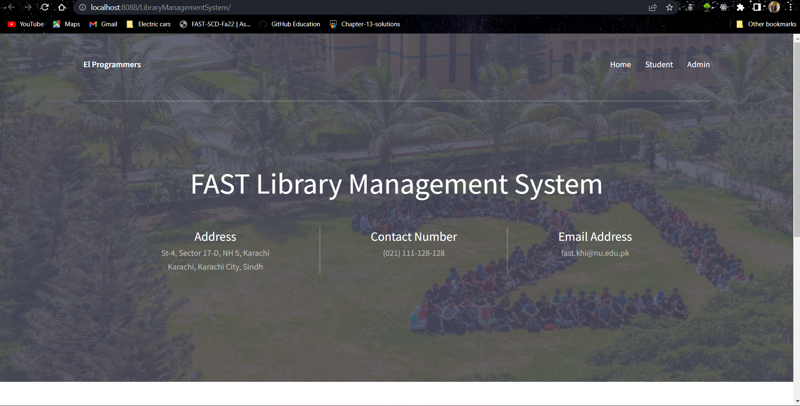
SAMPLE PICTURES (HOMEPAGE)

Slide 8
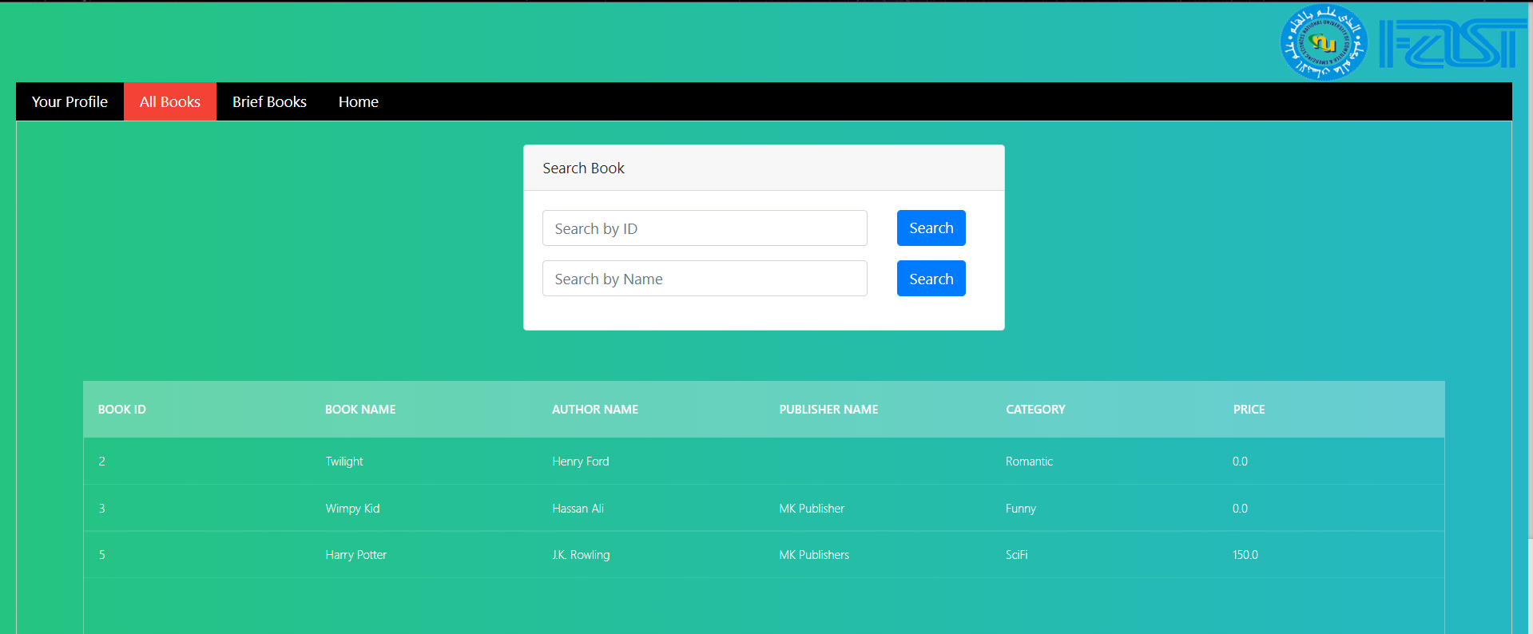
STUDENT PORTAL

Slide 9
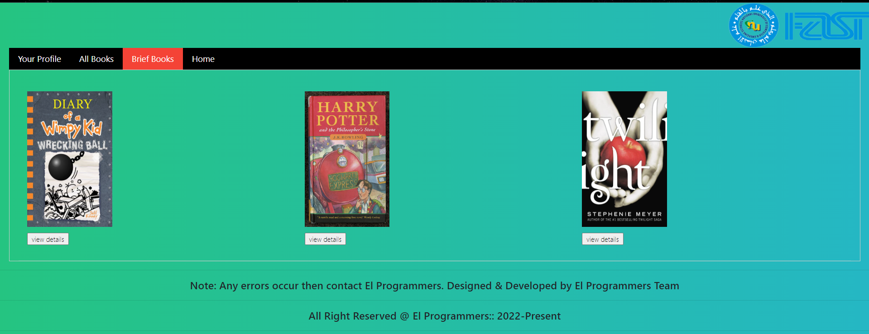

Slide 10
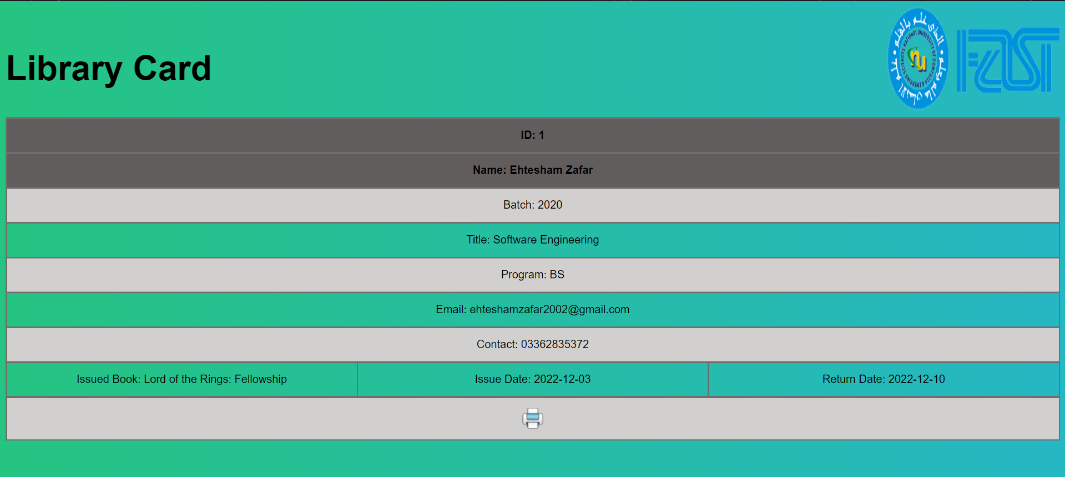

Slide 11
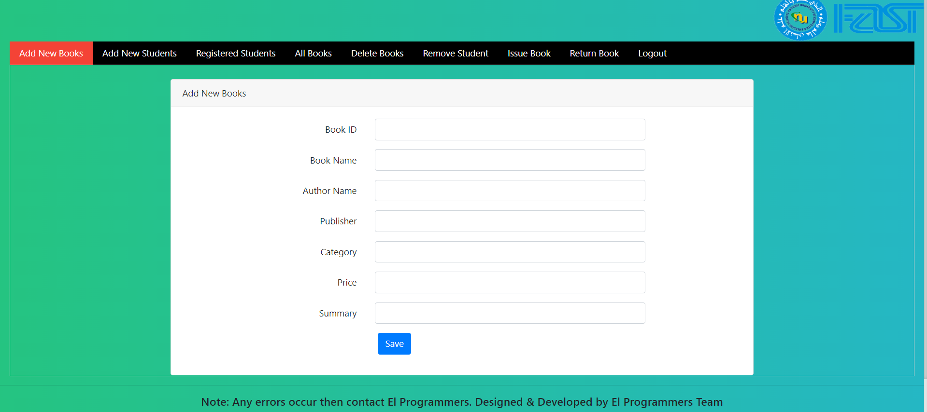
LIBRARIAN

Slide 12
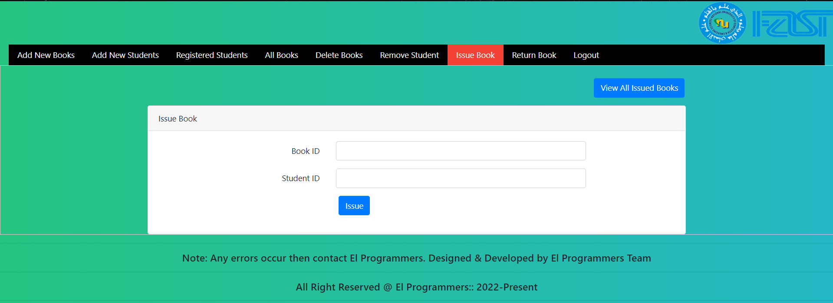

Slide 13
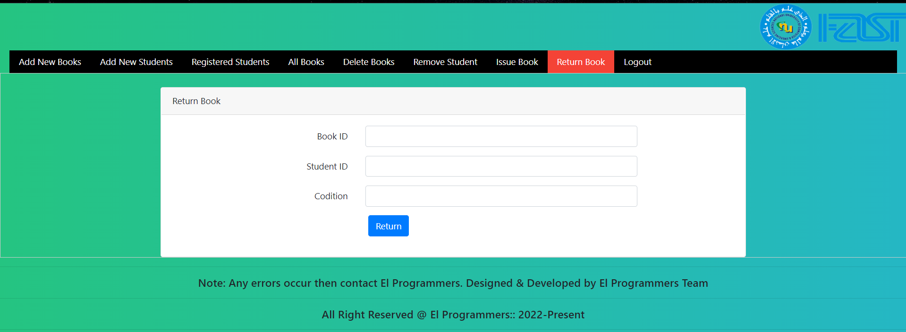

Slide 14
Thanks

